Slide 1


Stevin Hans FANSI WESIHEBA
1st July 2023

Slide 2

Outline
Executive Summary
Introduction
Methodology
Results
Conclusion
Appendix

Slide 3
Executive Summary
Summary of methodologies
Data Collection API
Data Collection with Web-Scrapping
Data Wrangling
Exploratory Data Analysis (EDA) with SQL
EDA with Visualization
Interactive Visual Analytics (Folium Lab, Plotly Dash, Dashboard)
Predictive Analysis (Machine Learning)
Summary of all results
EDA result
Interactive Analytics screenshots
Predictive Analytics result

Slide 4
Introduction
Project background and context
SpaceX advertises Falcon 9 rocket launches on its website, with a cost of 62 million dollars; other providers cost upward of 165 million dollars each, much of the savings is because SpaceX can reuse the first stage. Therefore, if we can determine if the first stage will land, we can determine the cost of a launch. This information can be used if an alternate company wants to bid against SpaceX for a rocket launch.
The goal of the project is to create a machine learning model to predict if the first stage will land successfully.
Problems you want to find answers to
Factors which determine if the rocket will land successfully.
The interaction amongst various features which determine the success rate of a successful landing.
Operating conditions needed to ensure a successful landing program.

Slide 5

Section 1

Slide 6
Methodology
Executive Summary
Data collection methodology:
Data was collected using SpaceX API and web-scraping from Wikipedia.
Perform data wrangling
One-hot encoding was applied to categorical features.
Perform exploratory data analysis (EDA) using visualization and SQL
Perform interactive visual analytics using Folium and Plotly Dash
Perform predictive analysis using classification models
How to build, tune, evaluate classification models

Slide 7
Data Collection
Methodology for Data Collection
Data collection was done using the “get” request on the SpaceX API.
Then, we decoded the response content as a Json using the “.json()” function and turned it into a pandas dataframe using “.json_normalize()”.
We then cleaned the data, checked for missing values and filled in missing values where necessary.
In addition, we performed web-scraping from Wikipedia for Falcon 9 launch records with BeautifulSoup.
The objective was to extract the launch records as a HTML table, parse the table and convert it to a pandas dataframe for future analysis.

Slide 8
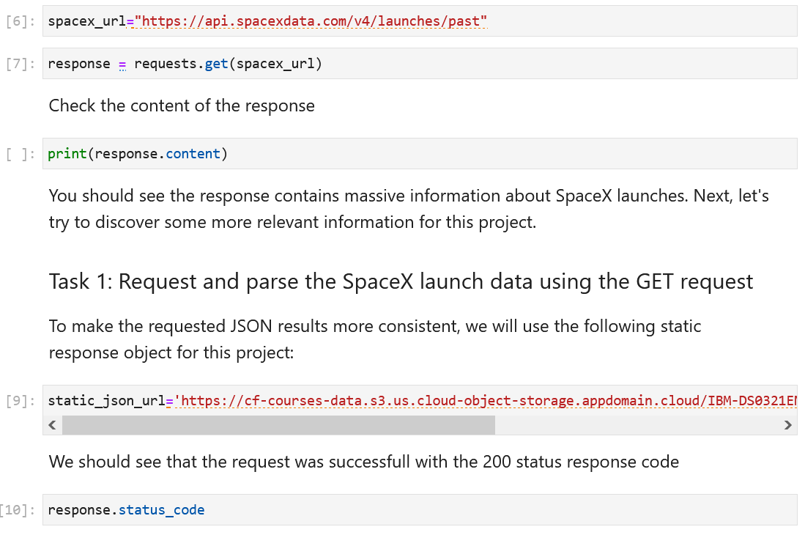
Data Collection – SpaceX API
We used the “get” request on the SpaceX API to collect data, we then cleaned the requested data and did some data wrangling and formatting.
https://github.com/StevinFansub/FirstRep/blob/main/Data%20Collection%20API.ipynb
Place your flowchart of SpaceX API calls here

Slide 9
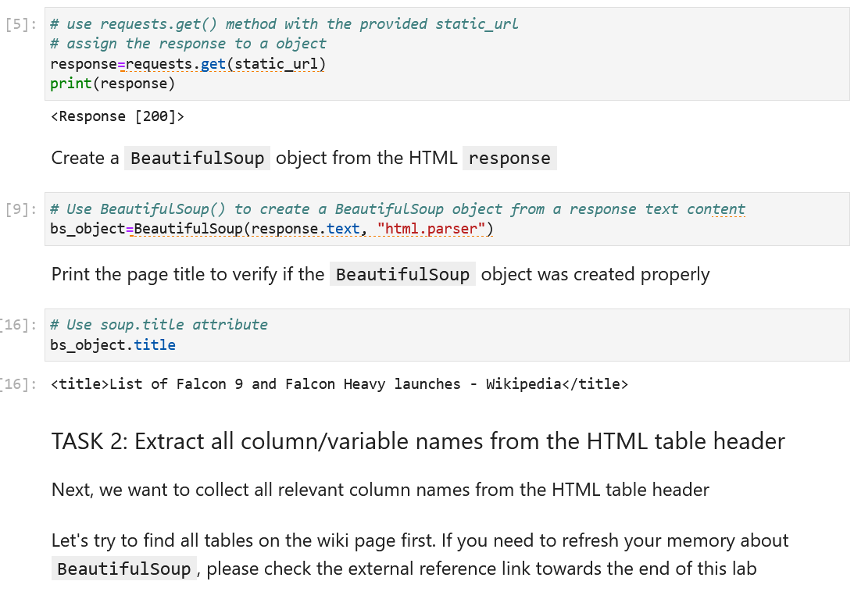
Data Collection - Scraping
We applied web-scrapping Falcon 9 launch records using “BeautifulSoup”
We parsed the table and converted it into a pandas dataframe.
https://github.com/StevinFansub/FirstRep/blob/main/Web%20Scrapping.ipynb
Place your flowchart of web scraping here

Slide 10

Data Wrangling
We performed Exploratory Data Analysis and determined the training labels
We calculated the number of launches at each site, and the number of occurrence of each orbits
We created landing outcome label from outcome column and exported the results to a csv file.
https://github.com/StevinFansub/FirstRep/blob/main/Data%20Wrangling.ipynb

Slide 11
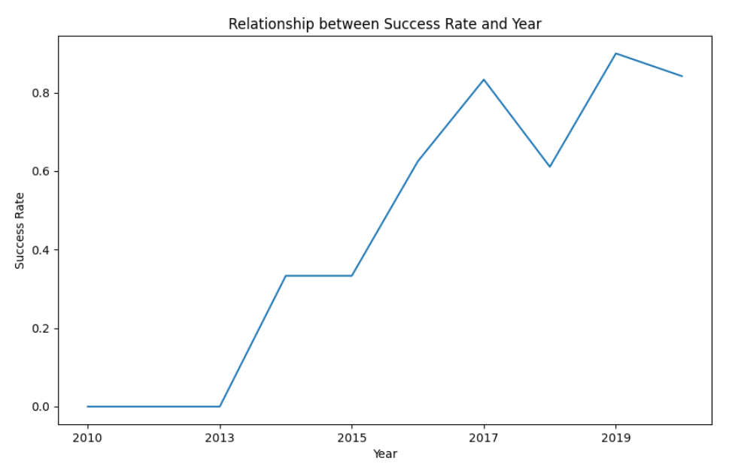
EDA with Data Visualization
We explored the data by visualizing the relationship between Flight Number and Launch Site, Payload and Launch Site, Success Rate of each orbit type, Flight Number and Orbit Type, yearly trend of launch success.
https://github.com/StevinFansub/FirstRep/blob/main/EDA%20with%20Data%20Viz.ipynb

Slide 12
EDA with SQL
We loaded the SpaceX dataset into a PostgreSQL database.
We applied EDA with SQL to get insight from the data. We wrote queries to find out:
The names of unique launch sites in the space mission.
The total payload mass carried by boosters launched by NASA (CRS)
The average payload mass carried by booster version F9 v1.1
The total number of successful and failure mission outcomes
The failed landing outcomes in drone ship, their booster version and launch site names
https://github.com/StevinFansub/FirstRep/blob/main/EDA%20with%20SQL.ipynb

Slide 13
Build an Interactive Map with Folium
We marked all launch sites, and added map objects such as markers, circles, lines to mark the success or failure of launches for each site on the folium map.
We assigned the feature launch outcomes (failure or success) to class 0 and 1, that is 0 for failure, and 1 for success.
Using the color-labeled marker clusters, we identified which launch sites have relatively high success rate.
We calculated the distances between a launch site to its proximities. We answered some questions such as:
Are launch sites near railways, highways and coastlines?
Do launch sites keep a certain distance away from cities?

Slide 14
Build a Dashboard with Plotly Dash
We built an interactive dashboard with Plotly dash
We plotted pie charts showing the total launches by a certain sites
We plotted scatter graph showing the relationship with Outcome and Payload Mass (Kg) for the different booster version
https://github.com/StevinFansub/FirstRep/blob/main/Dashboard%20with%20Plotly%20Dash.py

Slide 15
Predictive Analysis (Classification)
We loaded the data using numpy and pandas libraries, transformed the data and split our data into training and testing sets.
We built different machine learning models and tune different hyperparameters using GridSearchCV.
We used accuracy as the metric for our model, improved the model using feature engineering and algorithm tuning.
We found the best performing classification model
https://github.com/StevinFansub/FirstRep/blob/main/Predictive%20Analysis.ipynb

Slide 16
Results
Exploratory data analysis results
Interactive analytics demo in screenshots
Predictive analysis results

Slide 17

Section 2

Slide 18
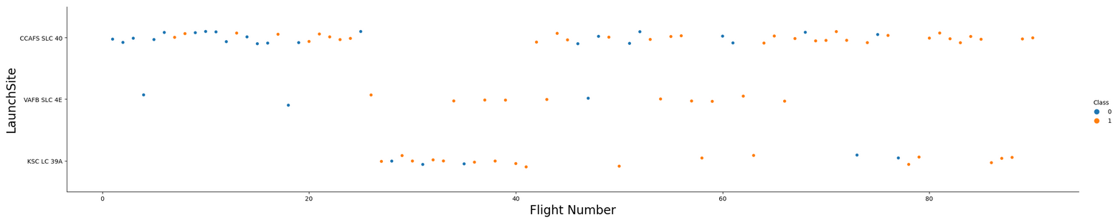
Flight Number vs. Launch Site
From the plot, we found that the larger the flight amount at a launch site, the greater the success rate at a launch site

Slide 19
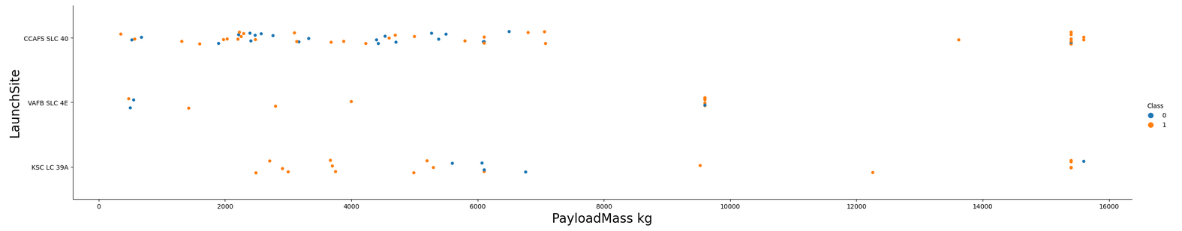
Payload vs. Launch Site
The greater the payload mass, for launch site CCAFS SLC 40 the higher the success rate for the rocket.

Slide 20
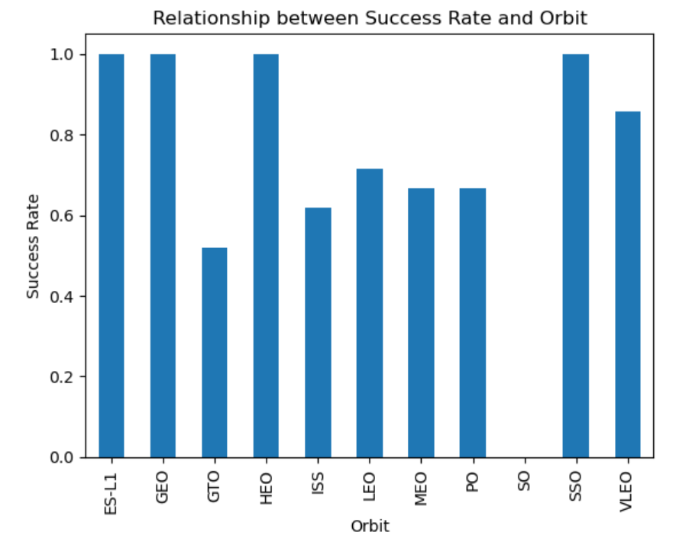
Success Rate vs. Orbit Type
From the plot, we can see that ES-L1, GEO, HEO, SSO, VLEO had the most success rate.

Slide 21
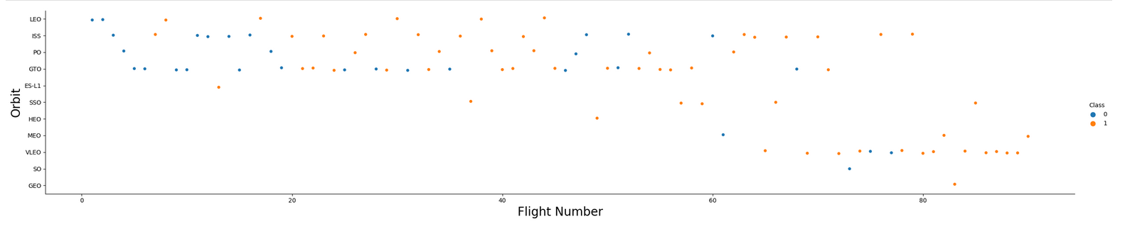
Flight Number vs. Orbit Type
We observe that in the LEO orbit, success is related to the number of flights whereas in the GTO orbit, there is no relationship between flight number and the orbit.

Slide 22
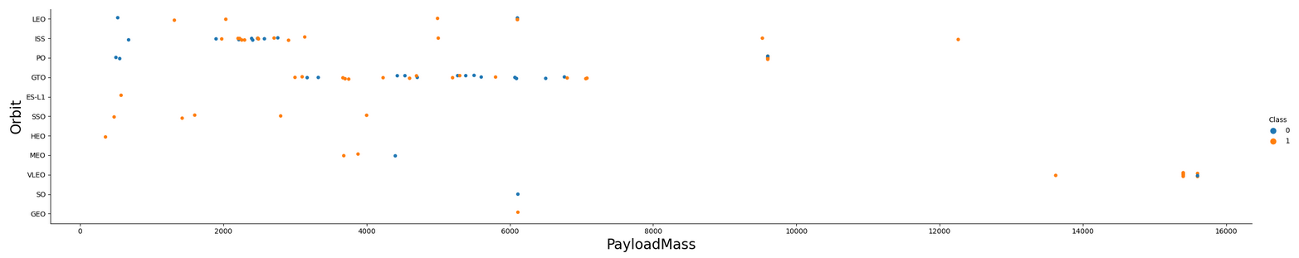
Payload vs. Orbit Type
With heavy payloads, successful landings mainly occur for PO, LEO and ISS orbits

Slide 23
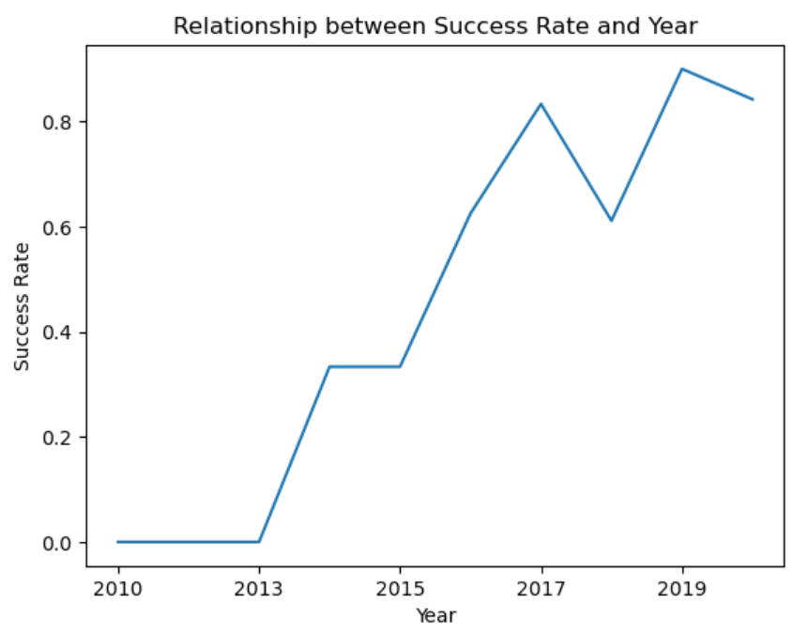
Launch Success Yearly Trend
From the plot, we can observe that success rate since 2013 kept on increasing till 2020

Slide 24
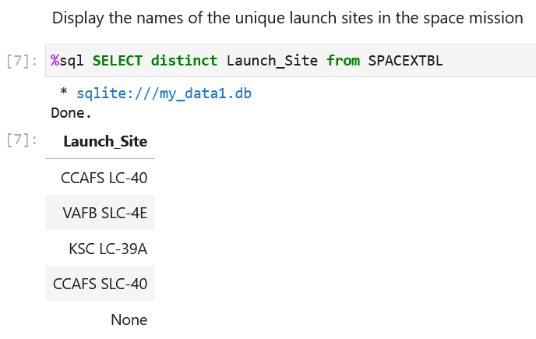
All Launch Site Names
We used the key word DISTINCT to show only unique launch sites from the SpaceX data

Slide 25
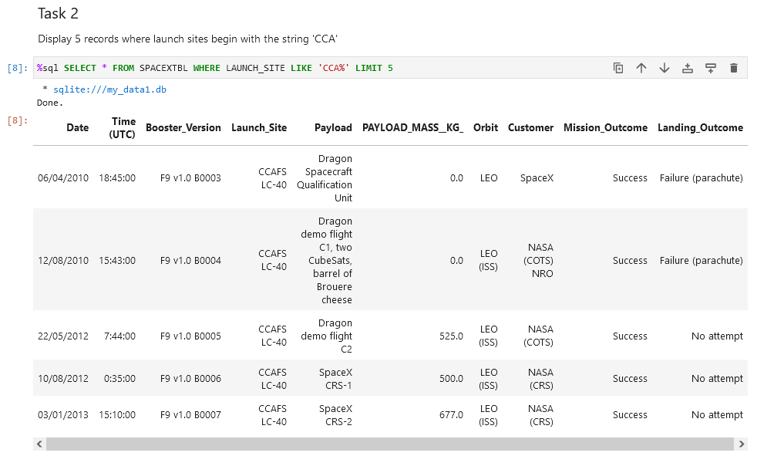
Launch Site Names Begin with 'CCA'
We used the query below to display 5 records where launch sites begin with “CCA”

Slide 26
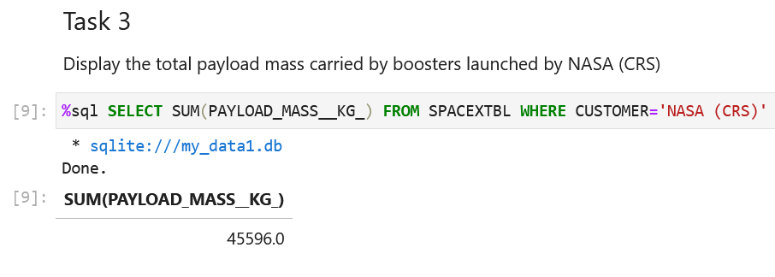
Total Payload Mass
We calculated the total payload carried by boosters from NASA as 45596

Slide 27
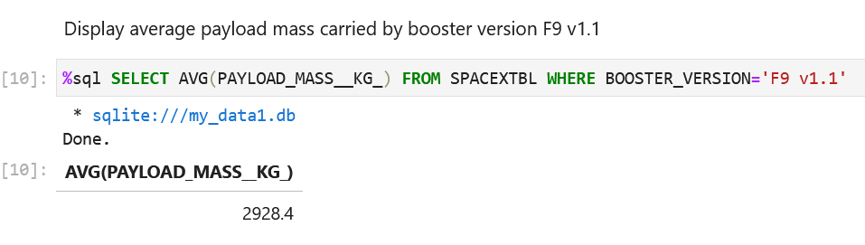
Average Payload Mass by F9 v1.1
We calculated the average payload mass carried by booster version F9 v1.1 as 2928.4

Slide 28
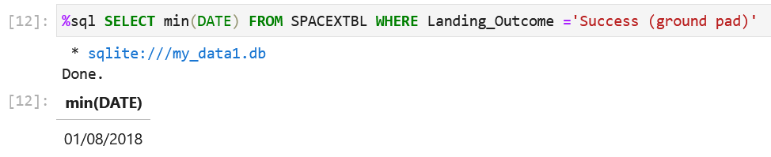
First Successful Ground Landing Date
On the 1st August 2018, the first successful ground landing occurred

Slide 29
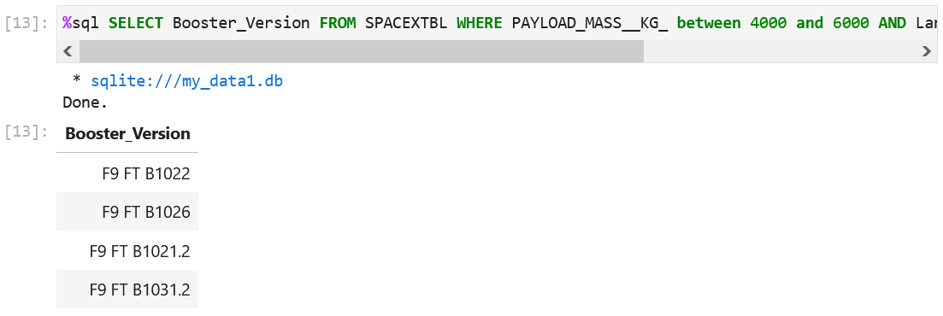
Successful Drone Ship Landing with Payload between 4000 and 6000
We used the WHERE clause to filter for boosters which have successfully landed on drone ship and applied the AND condition to determine successful landing with payload mass greater than 4000 but less than 6000

Slide 30
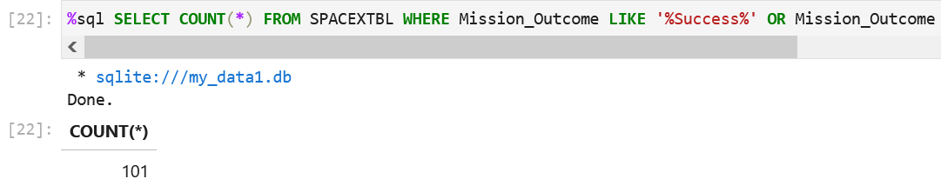
Total Number of Successful and Failure Mission Outcomes
We used wildcard like “%” to filter for WHERE MissionOutcome

Slide 31
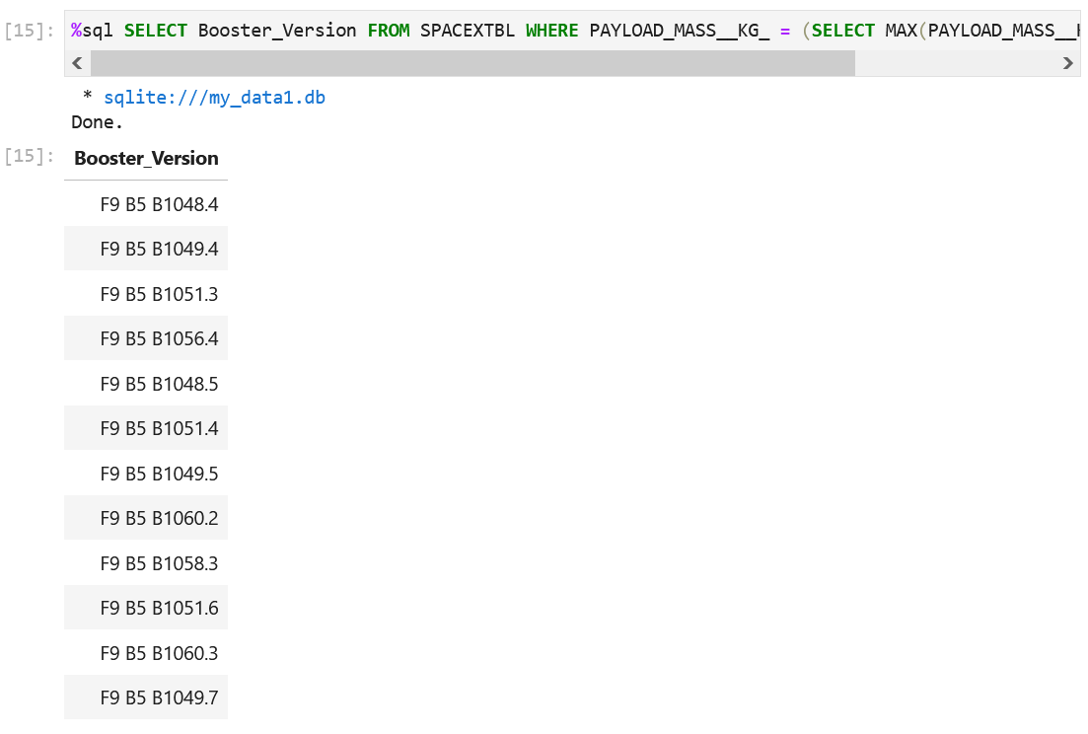
Boosters Carried Maximum Payload
We determined the booster that have carried the maximum payload using a subquery in the WHERE clause and the MAX() function

Slide 32
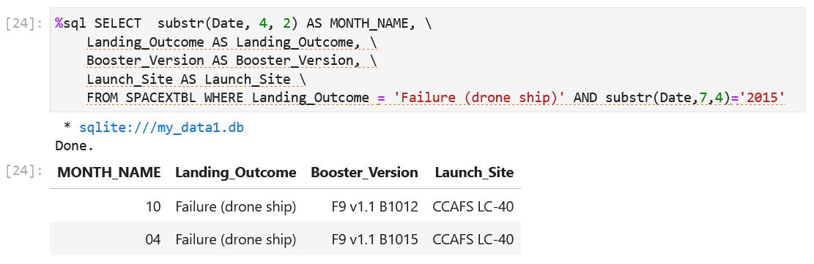
2015 Launch Records
We used the code below to list the records which will display the month names, failure landing_outcomes in drone ship ,booster versions, launch_site for the months in year 2015

Slide 33
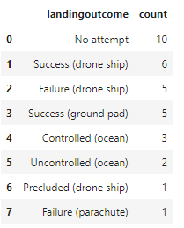
Rank Landing Outcomes Between 2010-06-04 and 2017-03-20

Slide 34

Section 3

Slide 35
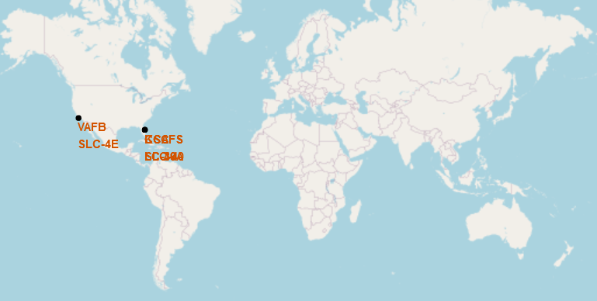
Launch Sites Global Map Markers
All the SpaceX lunch sites are in the USA coasts of California and Florida

Slide 36

Markers showing launch sites with color labels

Slide 37

Launch Site distance to landmarks

Slide 38

Section 4

Slide 39
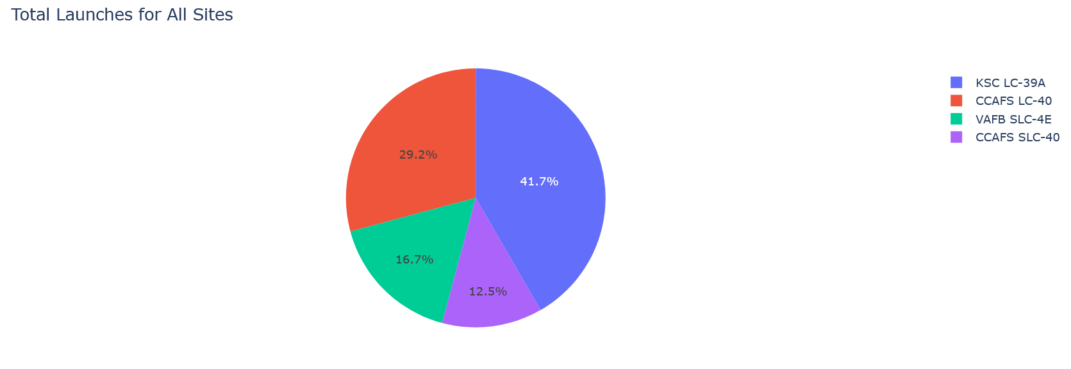
Launch Records
KSC LC-39A has the most successful launches

Slide 40
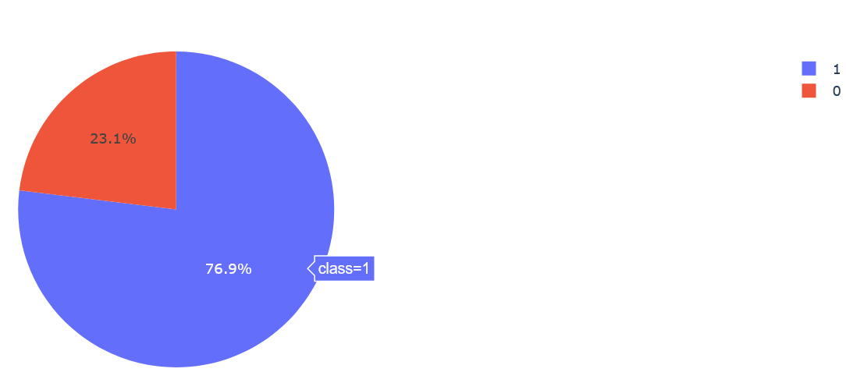
Highest Launch Success Ratio
KSC LC-39A achieved a 76.9% success rate while getting a 23.1% failure rate

Slide 41
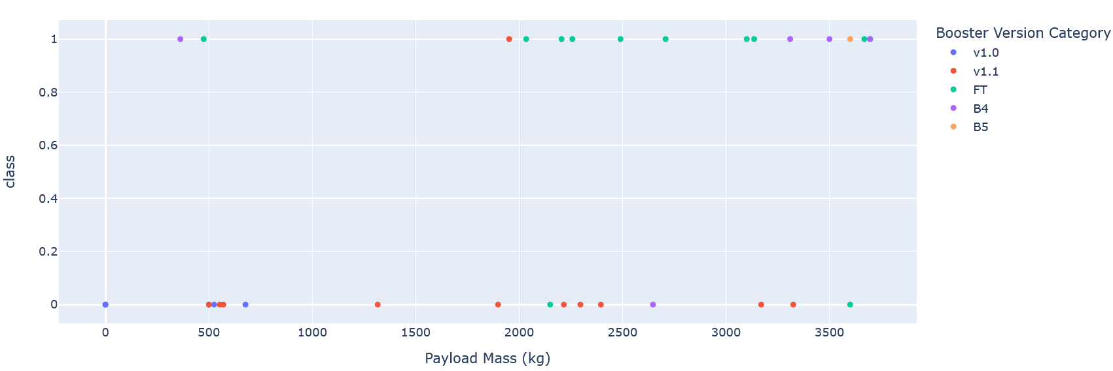
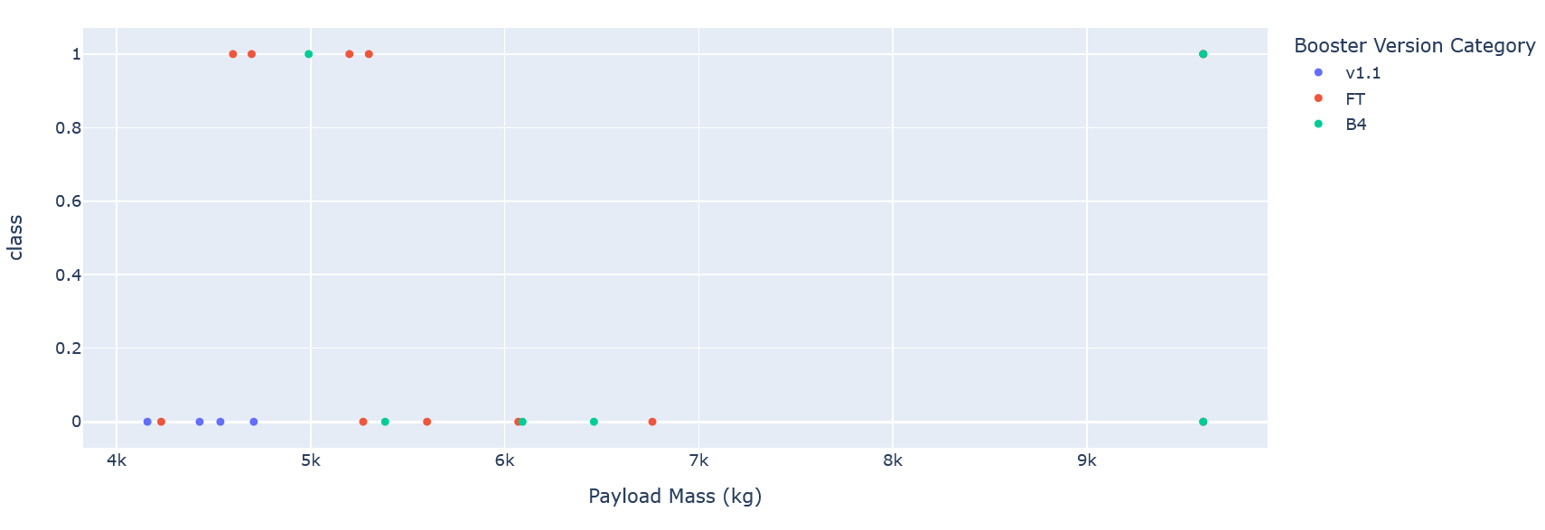
Scatter plot of Payload Vs Launch Outcome
Success rates for low weighted payloads is higher than those for heavy weighted payloads
Payloads from 0kg – 4000kg
Payloads from 4000kg – 10000kg

Slide 42

Section 5

Slide 43
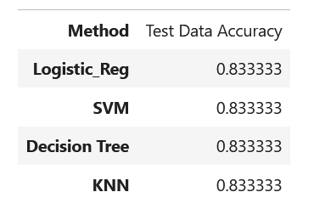
Classification Accuracy
We found that the models have the same accuracies

Slide 44
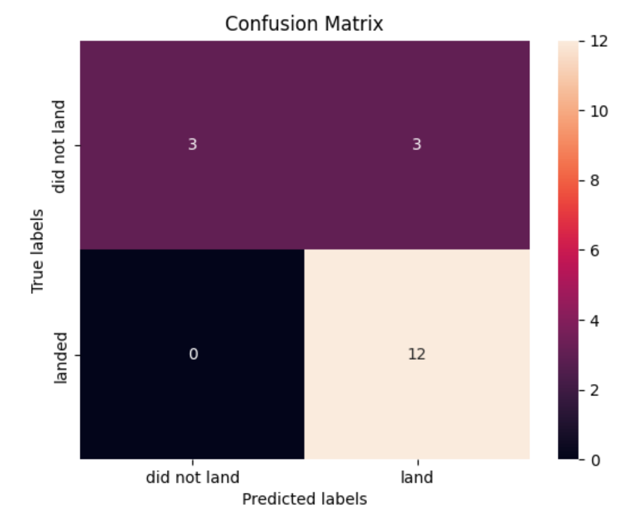
Confusion Matrix
The confusion matrix for the decision tree classifier shows that the classifier can distinguish between the different classes. The major problem is the false positives .i.e., unsuccessful landing marked as successful landing by the classifier

Slide 45
Conclusions
We can conclude that:
The larger the flight amount at a launch site, the greater the success rate at a launch site.
Launch success rate started to increase in 2013 till 2020.
Orbits ES-L1, GEO, HEO, SSO, VLEO had the most success rate.
KSC LC-39A had the most successful launches of any sites.
Any machine learning algorithm will work for this task

Slide 46


